Slide 1
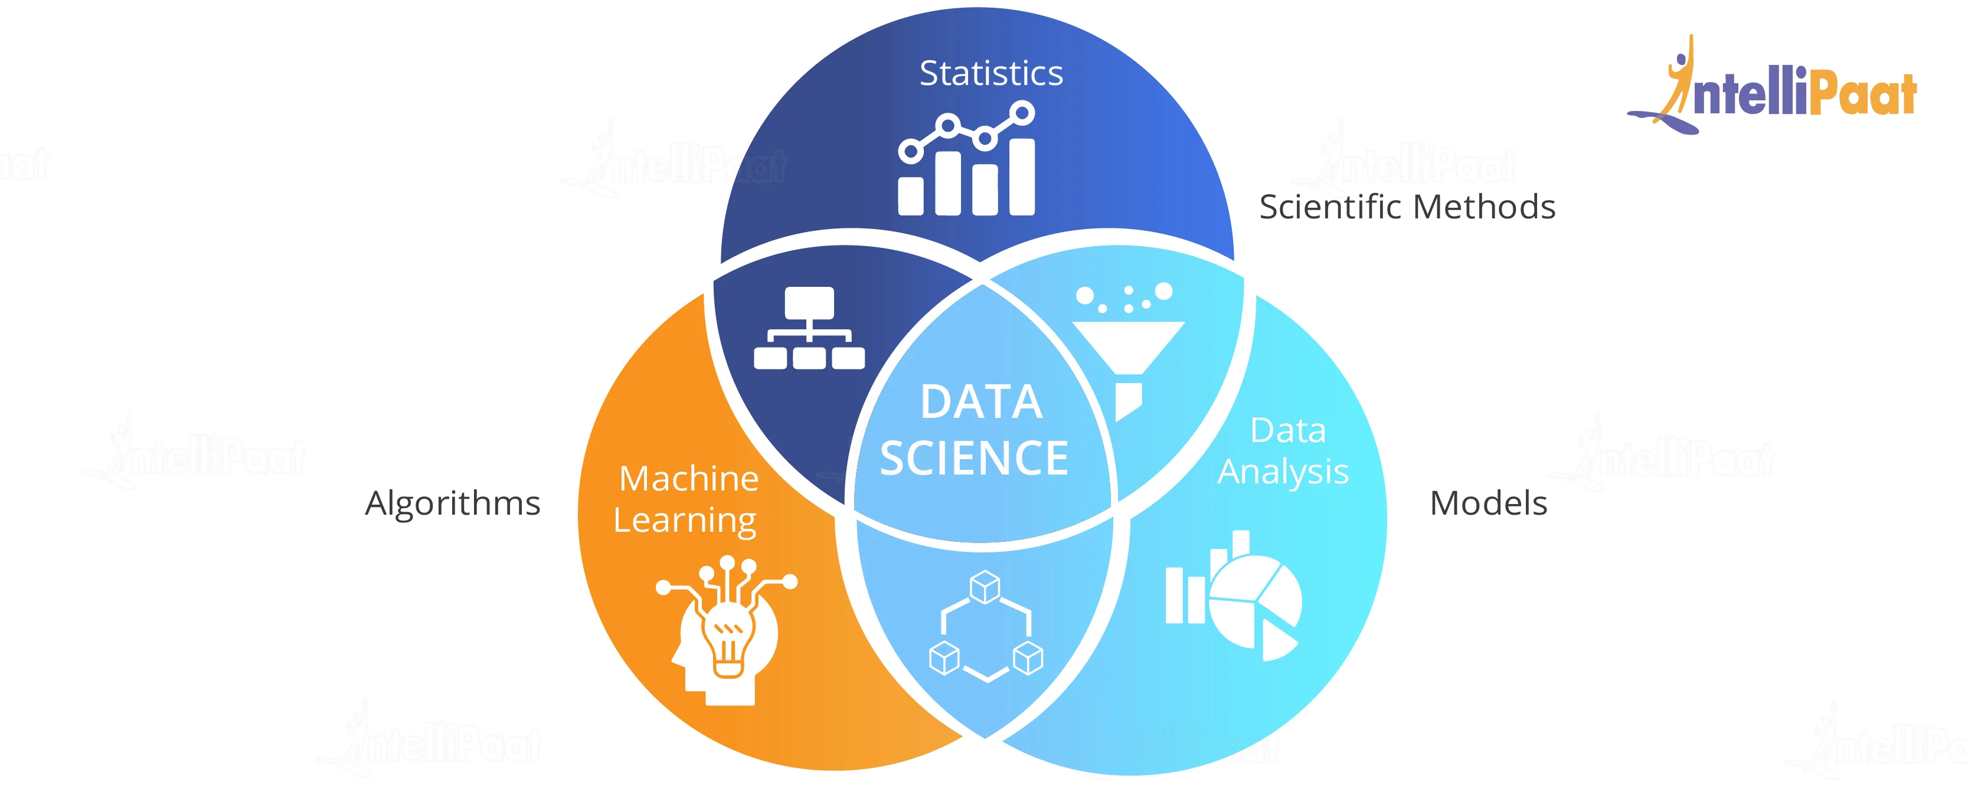
The Battle of Neighborhoods
Umang Jain
November 29, 2020

Slide 2

Content
1
Introduction
Data
Toronto City Places Like: Hotels,Parks,Caffe &
Restaurants
Methodology
Results
Places Clustering &
Visualizing Maps
The Battle of Neighborhoods

Slide 3
Introduction
2
Where would you recommend an art adventurer to visit in order to fulfill her/his hunger for various art pieces? The world is full of wonders and maybe the most ambiguous ones are considered as art. Many people dedicated themselves to travel around the world and discover these ambiguities.
The main purpose of this project is to make an ease to the adventurers visiting new cities in finding Hotels, Parks, Shopping Stores, Restaurants and Cafeteria as well.
The data used in this project is provided by Foursquare location data. The data are grouped by landscape area, and each area included the information about this area and all information about restaurants, cafes, and stores which in this area.
The Battle of Neighborhoods

Slide 4
Data
3
In order to accomplish this goal, latitudes and longitudes of the hotels,restaurants, cafes, and stores are required. The "simplemaps.com" offers a simple, accurate and up-to-date database of the world's cities and their locations. From this data, I need to select the 'Toronto' cities and using their latitude and longitude values, I need to explore the venues with "art" section around these places by utilizing Foursquare API.
The "simplemap" data contains name, corresponding latitude, longitude, postal code,address,state and categoey along with many other features for all place in the Toronto. I only use the features that I mentioned in this data and then filtered the for each places.
The Battle of Neighborhoods

Slide 5
Methodology
5
Stage 1 - Business Understanding: the main goal is to search for where is the best area in Toronto in term of Hotels and Parks.
Stage 2 - Analytic Approach
⁾ First identify which are the most areas in Toronto based on the Hotels, Parks, Caffe and Restaurants.
⁾ Next the areas are visualized on the map so users can be aware of those.
Stage 3 - Data Requirements
⁾ The data required for this work is described in the Data section.
⁾ venues information provided by FourSquare will be used also to give users an overview of their future ideal community.
The Battle of Neighborhoods

Slide 6
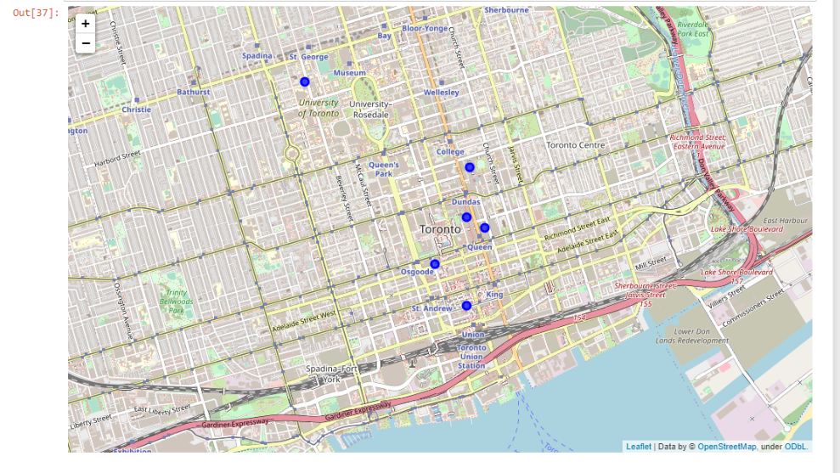
Results:
Hotels,Shopping and caffes
6
The Battle of Neighborhoods

Slide 7
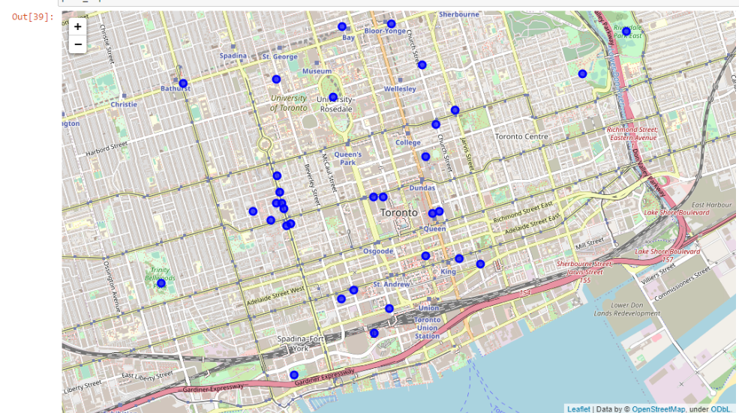
Results:
Parks and Restaurants
7
The Battle of Neighborhoods

